Slide 1

Brrrgrrr 🍔
Interactive Burger Ordering Frontend Application
Welcome to Brrrgrrr, a high-performance frontend laboratory project engineered with React and Vite. This application serves as a comprehensive exploration of modern UI interactivity, robust state management, and the power of ES6 syntax in a pure frontend environment.
Presented by: LABBI SRIKANTH BABU
Project Type: Frontend Project (EXPOSYS)

Slide 2
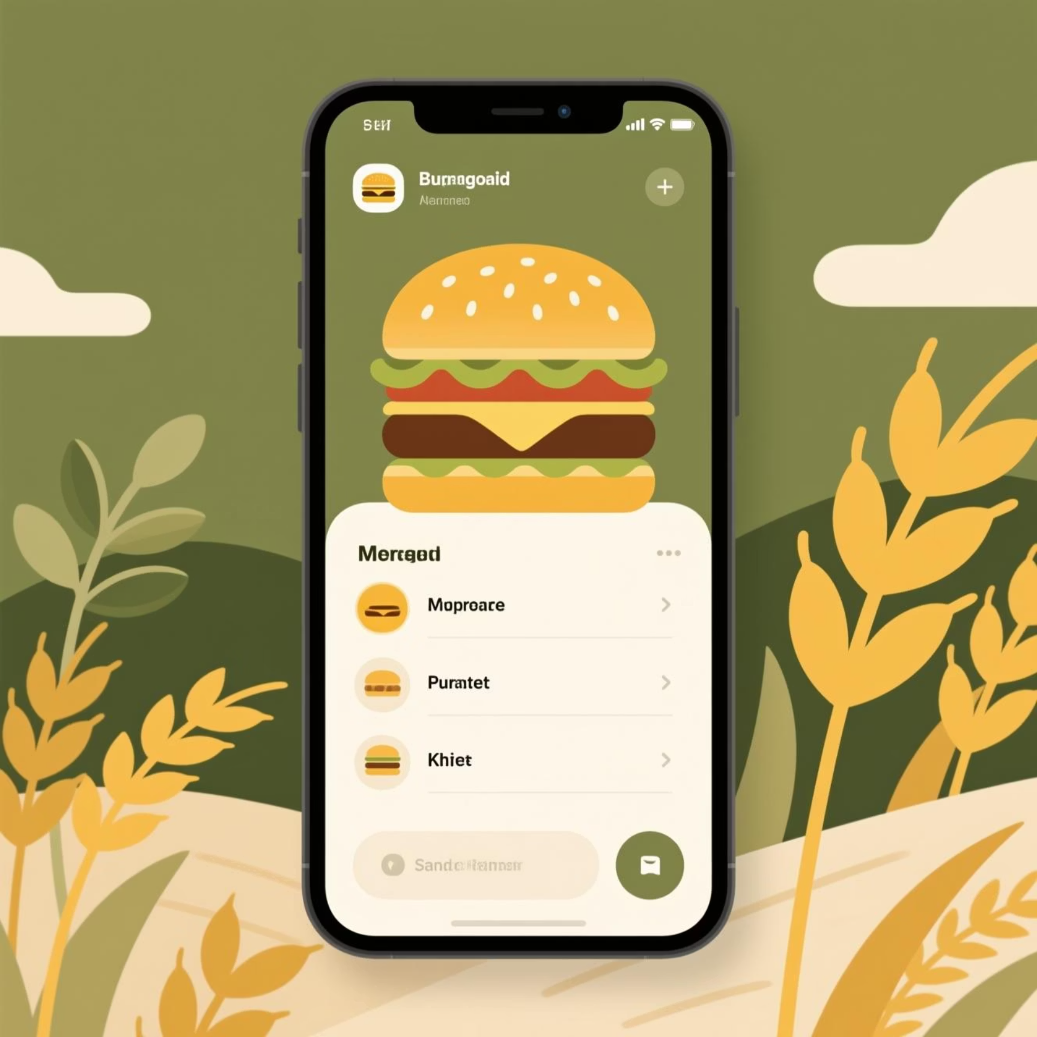

Project Overview
What is Brrrgrrr?
Brrrgrrr is a sophisticated online burger ordering platform designed to provide a seamless, tactile user experience. It empowers users to move beyond static menus, offering a deep level of customisation.
Dynamic burger customisation engine
Bespoke "Build from Scratch" interface
Comprehensive cart and checkout flow
Zero-backend architecture using mock data
Primary Goal: To demonstrate total mastery of React's lifecycle and
modern JavaScript concepts through a polished, interactive user interface.

Slide 3




Lab Objectives
Mandatory Technical Requirements
This project was built to satisfy rigorous technical benchmarks, ensuring that every interaction is
backed by efficient, modern code.
Data Handling
Virtual DOM
Extensive use of multidimensional arrays for ingredient and product management.
Pure React DOM manipulation to ensure high-performance UI updates without page reloads.
ES6 Compatibility
HOF Logic
Leveraging modern syntax for cleaner, more maintainable frontend logic.
Utilising map, filter, and reduce to handle complex state transformations.

Slide 4







Core Features
The application is split into four primary modules, each designed to simulate a real-world food technology product.
Build Your Own
Interactive Menu
A dynamic playground where users stack ingredients to create their perfect burger.
Real-time search and multi-category filtering for rapid product discovery.
Smart Cart
Admin View
A persistent state-managed cart with automated price and tax calculations.
A simulated backend dashboard for monitoring sales and inventory analytics.

Slide 5




Build Your Own Burger
Custom Creation Engine
The core of the Brrrgrrr experience is the dynamic customiser. Every click triggers a state update that reflects immediately in the UI.
Patties: Choice of Wagyu, Chicken, or Plant-based.
Veggies: Dynamic stacking of fresh produce.
Real-time Pricing: Price updates via useState hooks.

Slide 6




Menu, Search & Filtering
Finding the right burger shouldn't be a chore. We implemented high-speed data processing to manage our product lists.
Filter Array
Filter products by query and category
Type Query
Map Results
User enters text in search bar
Render filtered items to the UI
Categorisation
Search Logic
Rendering
Separate logic for Veg, Chicken, and Mutton categories.
Instant results using filter() as the user types.
Efficient list rendering using the map() function.

Slide 7
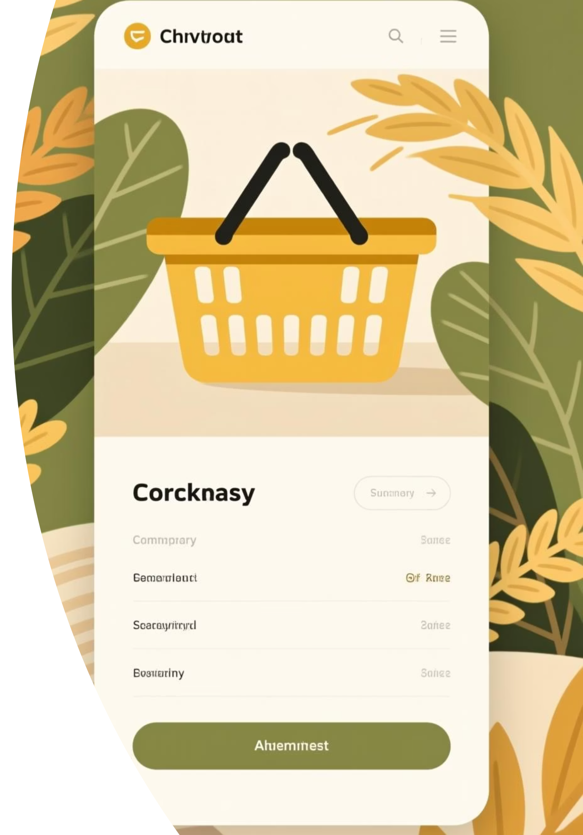



Cart & Checkout System
State-Driven Commerce
Add to Cart
Items are pushed into a global state array via Context API.
Modify Quantity
Logic to increment/decrement items while preventing negative values.
Total Calculation
The reduce() method aggregates the total cost in real-time.

Slide 8
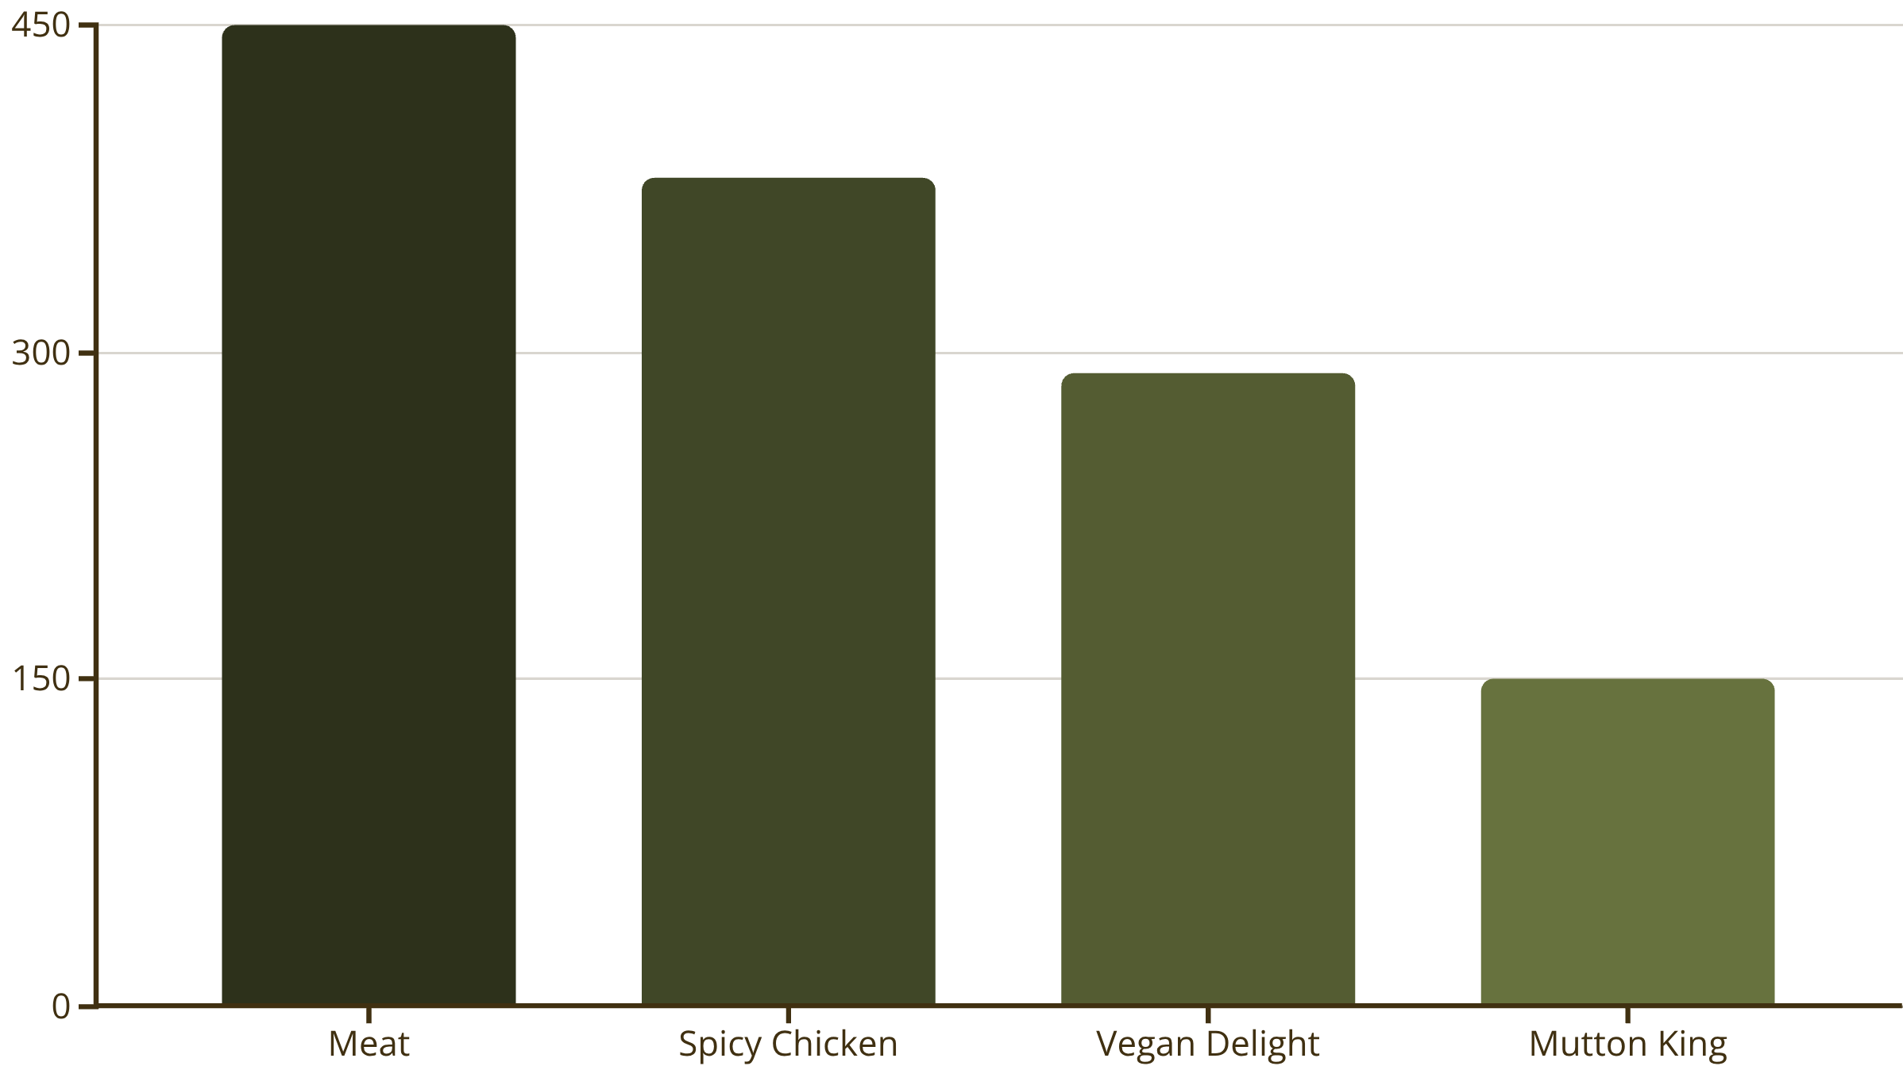
Admin Dashboard (Mock)
To demonstrate how the frontend would handle data from an API, we built a comprehensive visual analytics suite.
The dashboard simulates sales data to practice UI layouts for inventory management and order statistics.

Slide 9



Technical Implementation
Under the Hood of Brrrgrrr
Structures
Management
ES6 Features
Complex Object Arrays
React Context API
Destructuring & Spreads
By avoiding direct DOM manipulation and adhering to React's declarative pattern, the application remains lightweight and incredibly responsive to user input.

Slide 10
Conclusion & Outcomes
Project Summary
Future Roadmap
Brrrgrrr successfully bridges the gap between a simple tutorial and a production-ready frontend. It proves that with robust state management and modern JS, you can create immersive experiences without a backend.
Node.js Backend Integration
User Auth (Firebase)
Mastered React Functional Components
Implemented complex state logic
Stripe Payment Gateway
Prioritised User Experience (UX) design
Thank You!
GITHUB REPO: https://github.com/LABBISRIKANTHBABU/

